Slide 1
Forage- TATA Data Visuaisation
I am Madhav Khandelwal, and I am very excited to share some insights for your business. I hope you find the analysis helpful in making future business decisions and grabbing future opportunities.
I have first loaded the data in my system, checked for the errors and fixed them in order to provide an error free analysis.

Slide 2
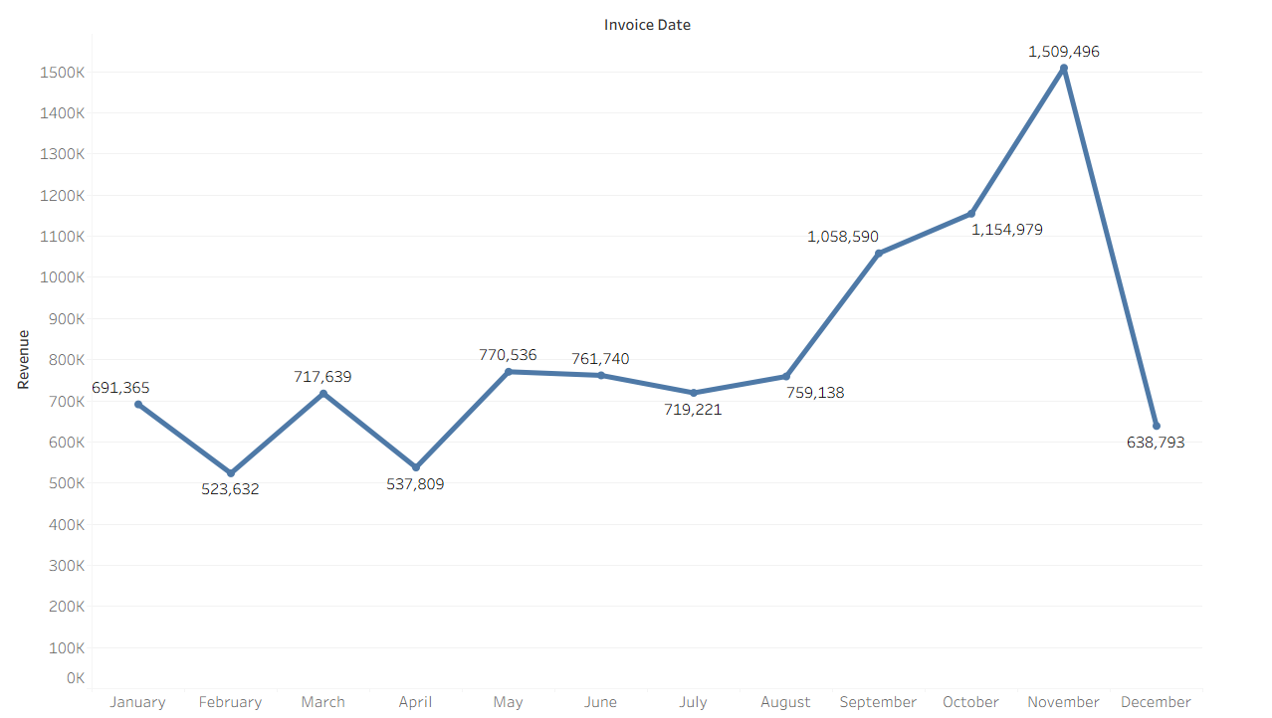
As for the first question, the CEO wanted to see the revenue trend and is there any seasonality in sales. My analysis shoes that there are some months where exceptional growth can be seen. The analysis shows that for the first seven months, the sales were fairly constant. The rise in sales started in the month of September and was highest in the month of November where it reaches 1.5 million USD. The data is incomplete for the month of December so no conclusion can be drawn for that month. The analysis shows that there is seasonality in the sales which occurs in the last four months of the year.

Slide 3
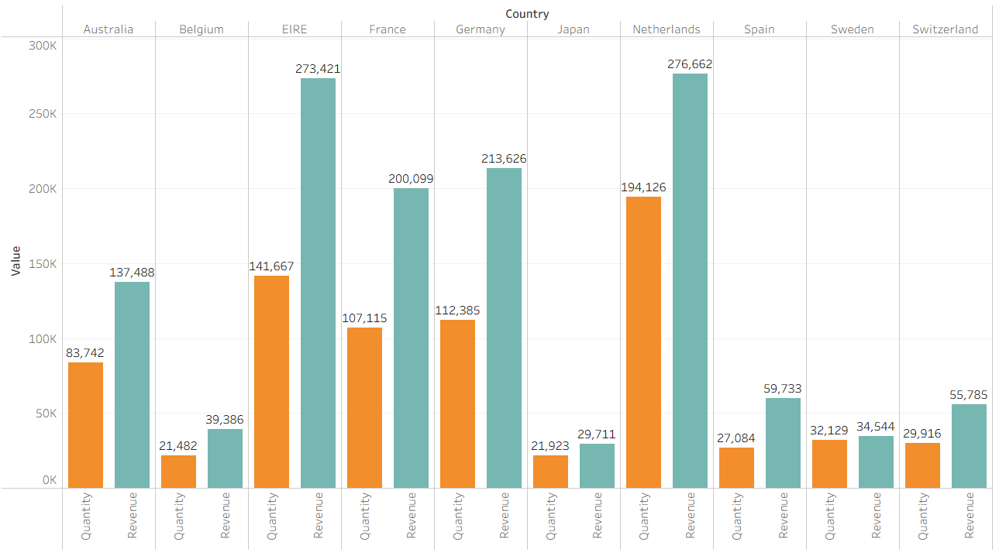
The second analysis shows the top 10 countries except United Kingdom that have growth opportunities. The visual shows that countries like Netherlands, Germany, France have high volumes of units brought and high revenue generated. I would suggest that the focus on these countries should be consistent and some strategies should be made for Australis’s market as it can be seen that the market has potential.

Slide 4
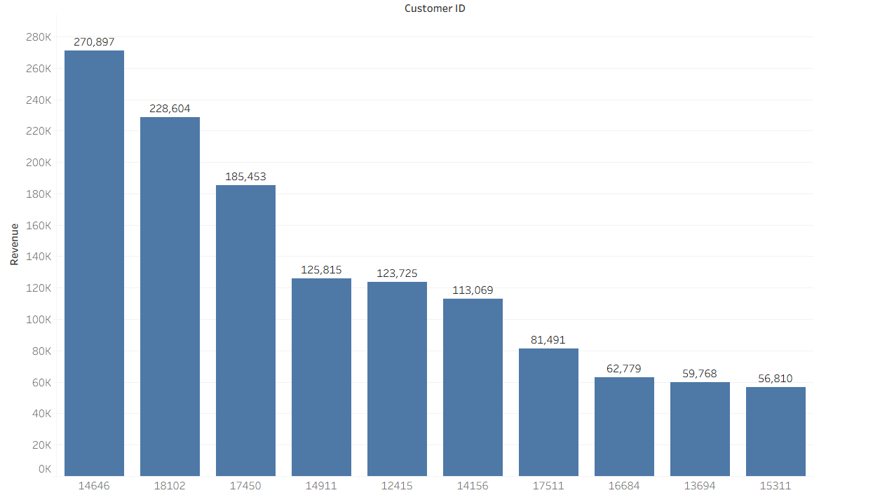
The third analysis shows the top 10 customers who have made the highest purchases. The data shows that the highest revenue generated form a single customer is of 270,897 USD and the second highest is 228,604 USD which shows that the business’s revenue’s chunk is not solely dependent on a single customer and the business is performing well.

Slide 5
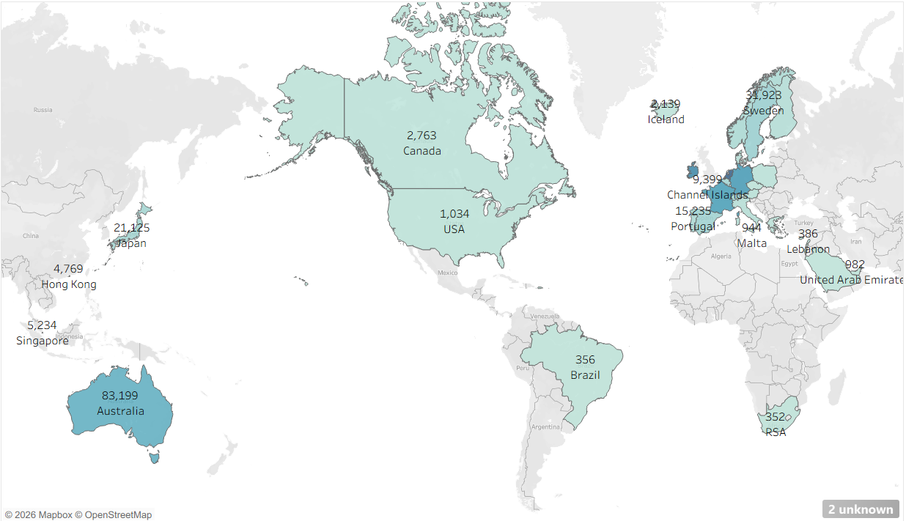
The map chart shows the countries that have generated the most revenue excluding United Kingdom. It can be observed that Netherland, Germany and other are generating high revenues and I suggest that the company should invest more to increase the demand for the products in these countries’ market. The map also shows that the Asian and African regions have no or very less demand for the products and Australian market has some demand and investing in that can help in grabbing opportunities.

Slide 6
THANK YOU

